Slide 1




Positive Energy® Smart Grid
Presented to:
New England Electric Restructuring Roundtable
October 28, 2011

Slide 2

OG&E Smart Grid
Agenda
Strategy
Scope
Benefits
Program Highlights
  Demand Response
  Distribution Automation
Conclusions

Slide 3
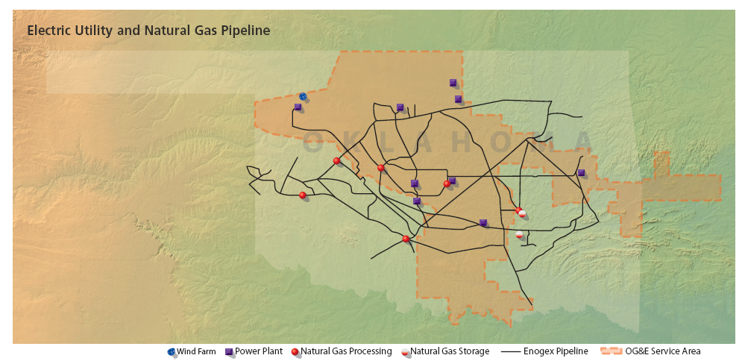

Profile: OGE Energy Corp
Enogex Inc.
8,200 miles of pipeline
9 processing plants
24 BCF of natural gas storage
6,600 MW capacity:
  9 power plants
  3 wind farms
783,000 customers in
Oklahoma & Arkansas
30,000 square mile
service area
23,000 miles of OH and 10,000 miles of UG distribution lines
500 substations
1100 dist. circuits

Slide 4
Strategy:
What Are We Doing and Why?

Slide 5
CEO’s Challenge:
“Together, we can delay the need for additional fossil-fueled power generation until 2020 or beyond”
How?
Renewables - Additional wind generation
Build transmission to deliver wind energy
Increased focus on Energy Efficiency (DSM)
Deploy Smart Grid technology (“…innovative technologies for partnering with our customers”)

Slide 6
OGE Smart Grid: Main Functional Areas
Advanced Metering Infrastructure (AMI)
    Smart meters for all customers
    Remote disconnect
    2-way communications
Demand Response (DR) Programs
    Dynamic pricing
    In-home technology
    Customer engagement
  Distribution Automation (DA) Technologies
    Automated switching
    Volt–VAr Optimization
    Centralized control
  All enabled through integrated wide area communications network, IT systems and supporting business processes
AMI
DA
DR

Slide 7

Targeted Benefits
  Enhanced customer relationships & engagement
  Reduced Operating Costs
    Truck rolls, Meter Operations
    Write Offs, Theft
  Reduced Peak Demand
    Deferred Generation Capacity Additions
  Improved Safety
  Improved Reliability
  Improved Efficiency
  Environmental

Slide 8

Impact of DOE Grant - A Game Changer
Revised Plan: Schedule Compression
  3 Year System Wide Deployment Window (2010 – 2012)
  Accelerated Regulatory Approval
  ~800,000 meters
  ~40,000 DR Customers
  Web Portal for All
  System Wide Comm Network
  Supporting IT Systems
  DA, DMS, System Field Inventory

Slide 9
Demand Response

Slide 10
Demand Response:
New Dynamic Pricing Tariffs
Summer Months June – September
Hours: 2-7 PM, M-F
Customers receive day-ahead price via in-home display, web, text, email, voice message
Tariff is Optional
Customer decides how to respond & manage consumption
FPO
All electricity is not created equally – as demand increases, the cost to generate and deliver electricity increases

Slide 11
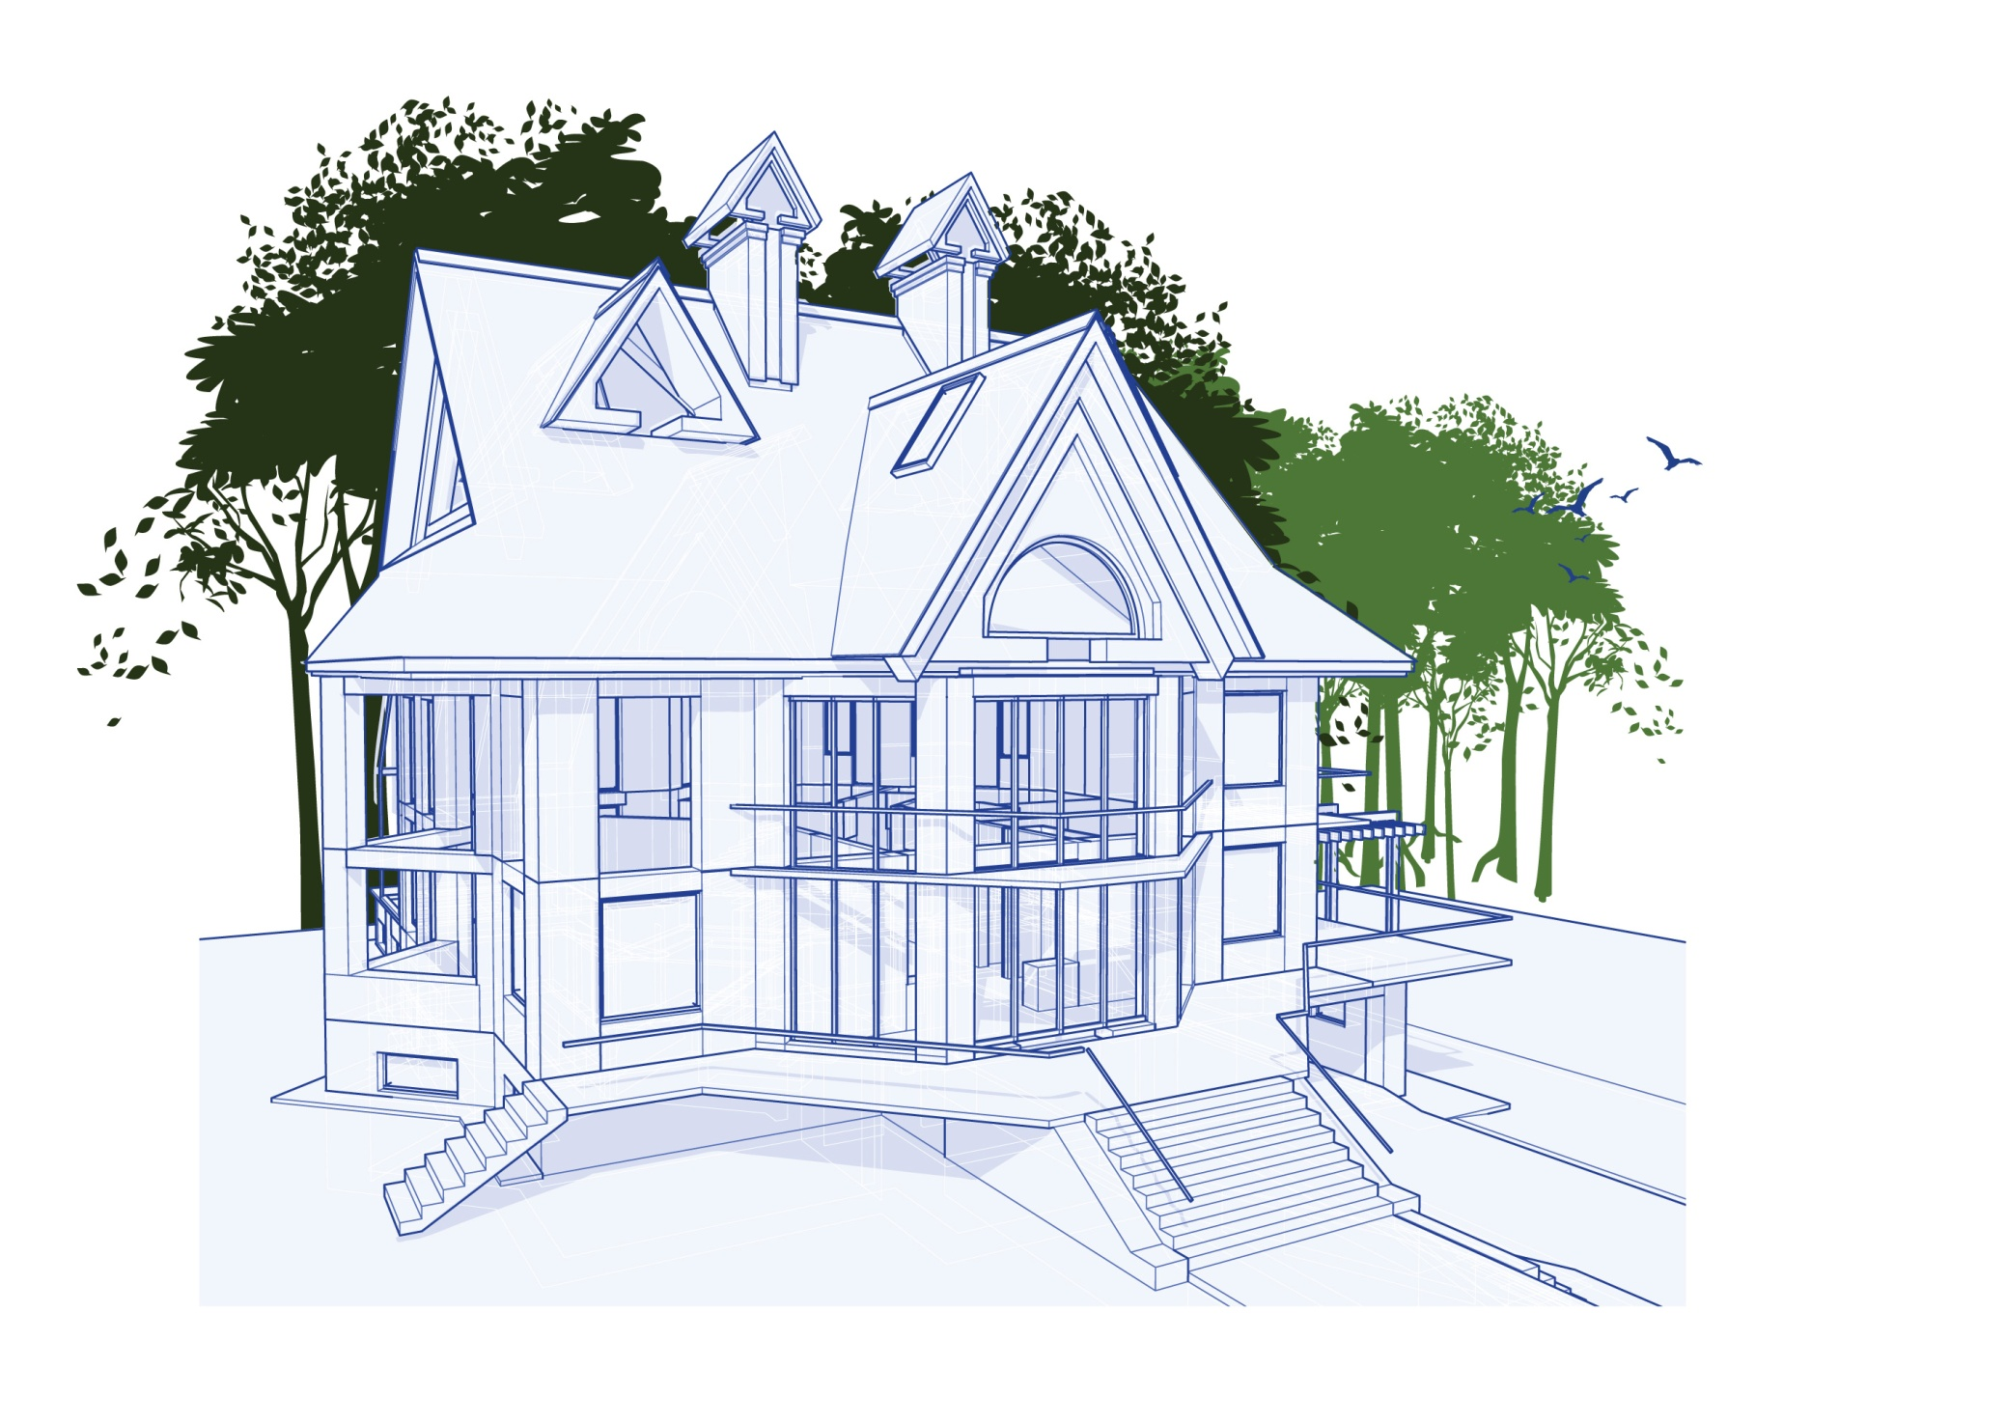
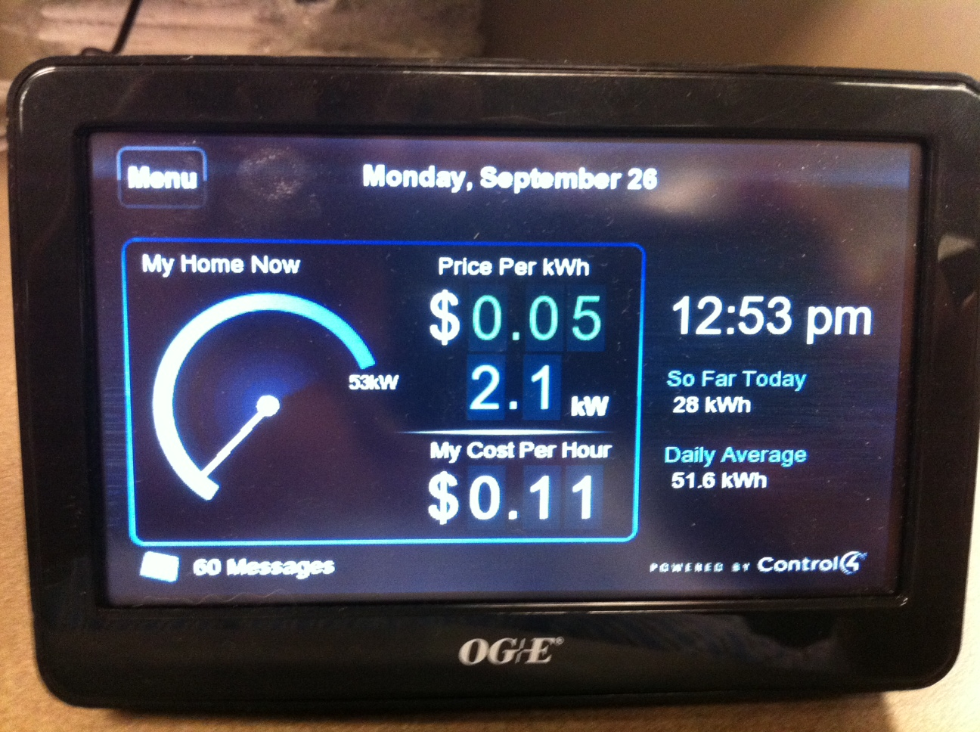
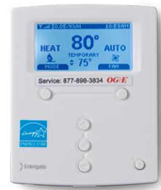
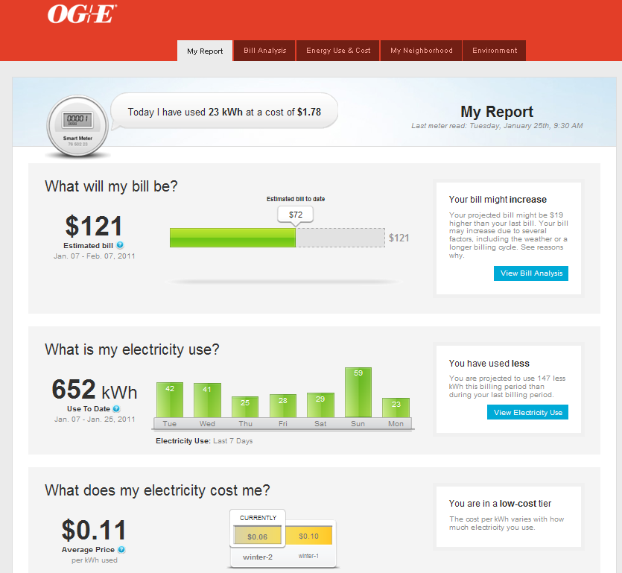
Home Area Network Technology:
New Tools for Energy Awareness

Slide 12
VPP and Technology Impact (Summer 2010)
6
5
4
3
2
1
0
Control
PCT
kW
IHD
Web
All
1 2 3 4 5 6 7 8 9 10 11 12 13 14 15 16 17 18 19 20 21 22 23 24
Hour Ending
Notes:
All group had a 1.63kW reduction

Slide 13
Distribution Automation Technologies

Slide 14
Distribution Automation
Distribution Management System (DMS)
centralized control for grid visibility, control and optimization
Automated Switching “Self Healing Grid”
Volt – VAR Optimization
Install Reclosers on 200 Circuits
Communicating Fault Indicators
Improved Reliability:
      Outage Duration (SAIDI)
      Outage Frequency (SAIFI)
Install Capacitor Controllers on 400 Circuits
    Reduce Peak Demand
    Regulate Voltage
    Reduce Electrical Losses
Other DMS features:
Switch Order Preparation
Load Flow & “What if” Analysis
Interactive Graphical User Interface
Integrated with Outage Management
Conducting Distribution Field Inventory: Identify and correct data errors in GIS model

Slide 15
  Non-Automated Circuit - Illustration
Substation Breaker opens and de-energizes entire line
All Customers on circuit experience a power outage until crews can perform manual switching
Substation A
Normally
Open
Switch
Substation B
Breaker senses
Fault &
Locks Out

Slide 16
  Automated Circuit – The “Self Healing” Grid
Fault Isolated and Power Restored to Non-faulted Line Section
Customer Impact Reduced by 66%
Substation A
Normally
Open
Device
Substation B
R
R
R
R
R
R
R
R
Recloser senses
Fault &
Locks Out
DMS sends
trip command to isolate faulted section
DMS verifies capacity and sends
close command

Slide 17
  Volt-Var Optimization (VVO)
  Objectives & Benefits
  Reduce voltage drop at end of line to provide more flexibility for voltage control at the feeder source
    Peak Energy Demand Reduction
  Improve power factor and voltage profile along entire feeder
    Loss minimization – less fuel needed to serve load
  Provide for more precise voltage regulation
    Better power quality for customers
  Provide remote control and alarm sensing of capacitor banks
    Reduced costs to manually control and inspect banks

Slide 18
  VVO: Conservation Voltage Reduction
Substation
Capacitors serve to raise the line voltage and flatten the voltage profile
Voltage
Provides ability to reduce source voltage while maintaining adequate voltage to customers
Reduce
Voltage
(& Demand)
4V
Distance From Source

Slide 19
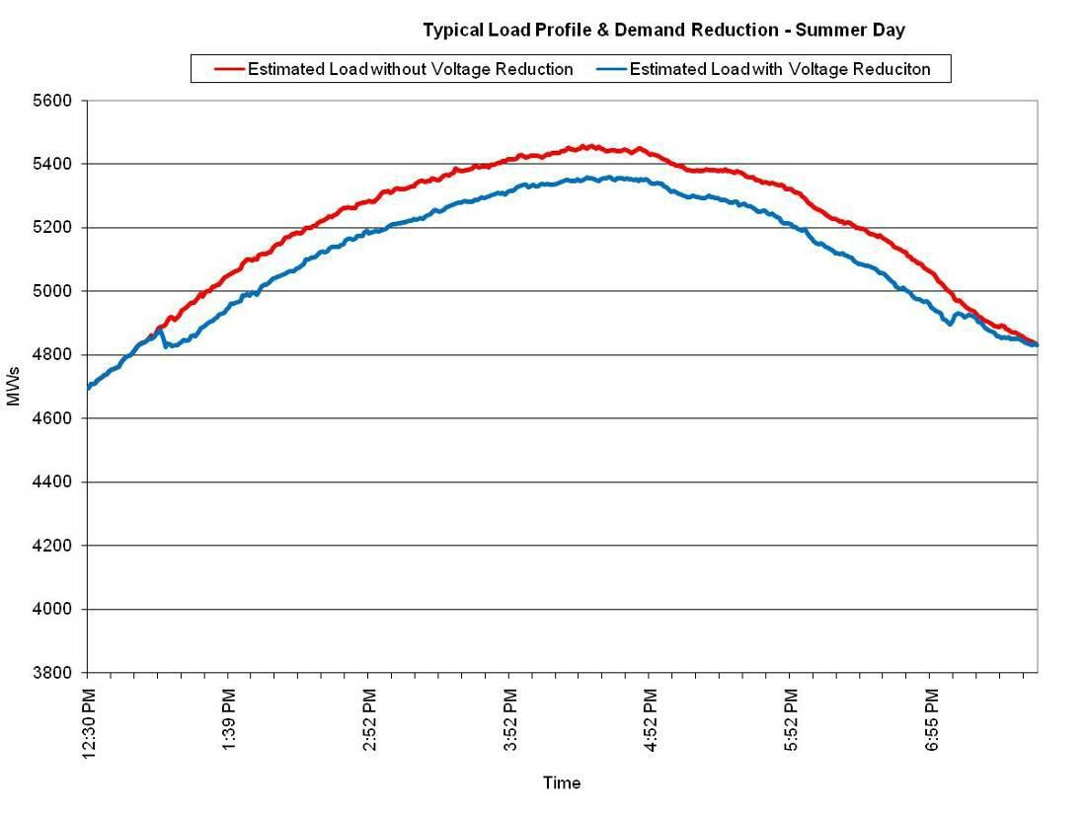
  VVO: Demand Reduction Objective
1% voltage reduction expected to result in 0.5 to 1% drop in demand
Typical demand reductions range between 0.5 - 2.5%
Assumption: 200kW per feeder reduction x 400 circuits = 80 MW

Slide 20
Current Status / Looking Ahead

Slide 21
Program Milestones (where are we now?)
Over 400,000 meters installed (50%)
  Started billing through AMI system immediately
  Integrated disconnect/reconnect with CIS
Meter Data Management System operational 2010
Customer Energy Information Portal live Jan. 3 2011
Wide Area Network (WAN) under construction (50%)
Manager of Managers (MOM) and Enterprise Service Bus (ESB)
DA deployed by YE 2011
  ≈ 60 reclosers on 24 circuits
  ≈ 270 capacitor controllers on 45 circuits
DMS completed FAT; go-live Q1 2012
DR and VVO year 1 & 2 studies completed
DOE Grant : Approx $65 million received

Slide 22
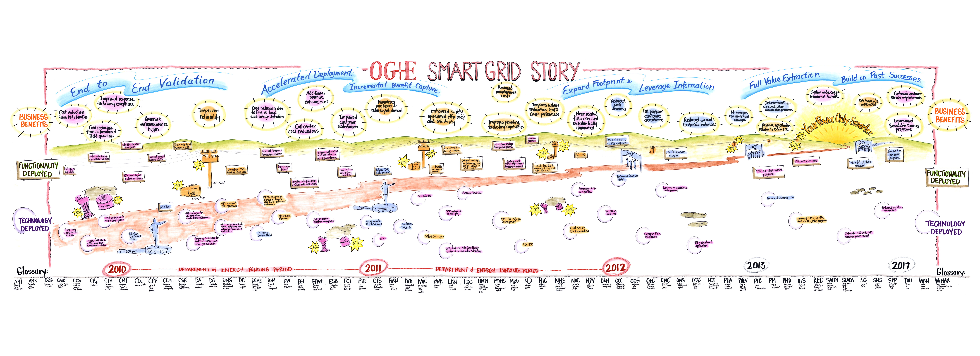
The Journey has Just Begun. . .
Multi-year release plan for technology deployment, business functionality and associated benefit capture
Transformational for business and customers
      Continuous education effort, externally and internally
      Process design, training, organizational & staffing plans
Transition planning from Project to Operations
Development of future products and services

Slide 23



Slide 24
Appendix

Slide 25

Stated Goals in Filed Testimony
  Meter Operational Savings:
    Meter Reading ~$15M/Yr
    300,000 connect/disconnect orders/Yr
    200,000 move in/out orders/Yr
    Theft Reduction: $8.2 M/Yr
  Net Headcount Reduction: 135
  Customer Participation Goals:
    20% penetration
    1.3 kW per customer
  Demand Reduction: 298 MW
    DR: 223 MW; VVO: 75 MW
  Avoided Generation Cost: $287 M (15 Yr NPV)
  Energy Reduction (VVO): 106 GWh/Yr
  Reliability: 30% SAIDI reduction
    DA Societal Benefits: $300 M/Yr

